Slide 1


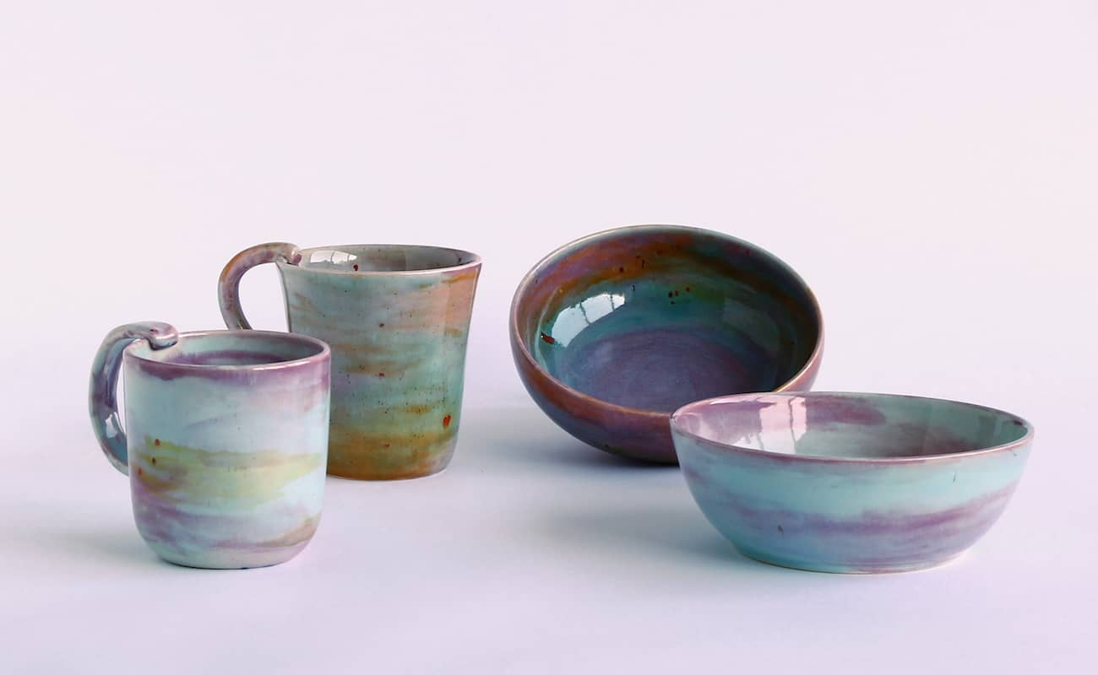
Ceramics
Universidad Autónoma de Nuevo León
Facultad de Ingeniería Mecánica y Eléctrica
Jaime Octavio Lopez Vazquez
1809483 IMTC
Materials Science M4-M6
Dr. Bindu Krishnan

Slide 2

Ceramics
Inorganic materials that are essential to our lifestyle
All around us
Lightweight or dense
Strong and hard
Usually Brittle

Slide 3
Classification
Two major systems for classification
Application Base System
Composition Base System
Traditional
Advanced
Electro-ceramics
Advanced Structural

Slide 4
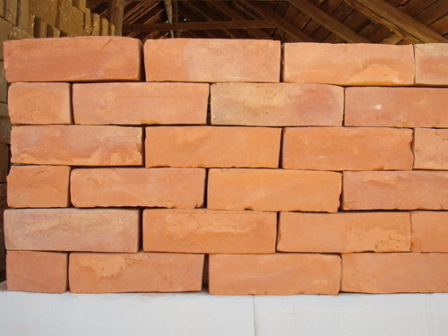
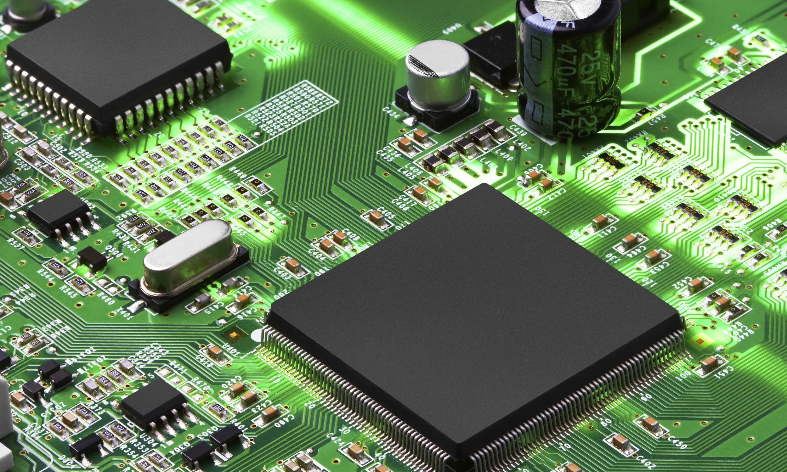
Application base System
Traditional
Whiteware, Structural Clay Products, Bricks and Tile, Abrasives, Refractories, Cement, etc.
Advanced
Electro Ceramics and Advanced Structural Ceramics.

Slide 5
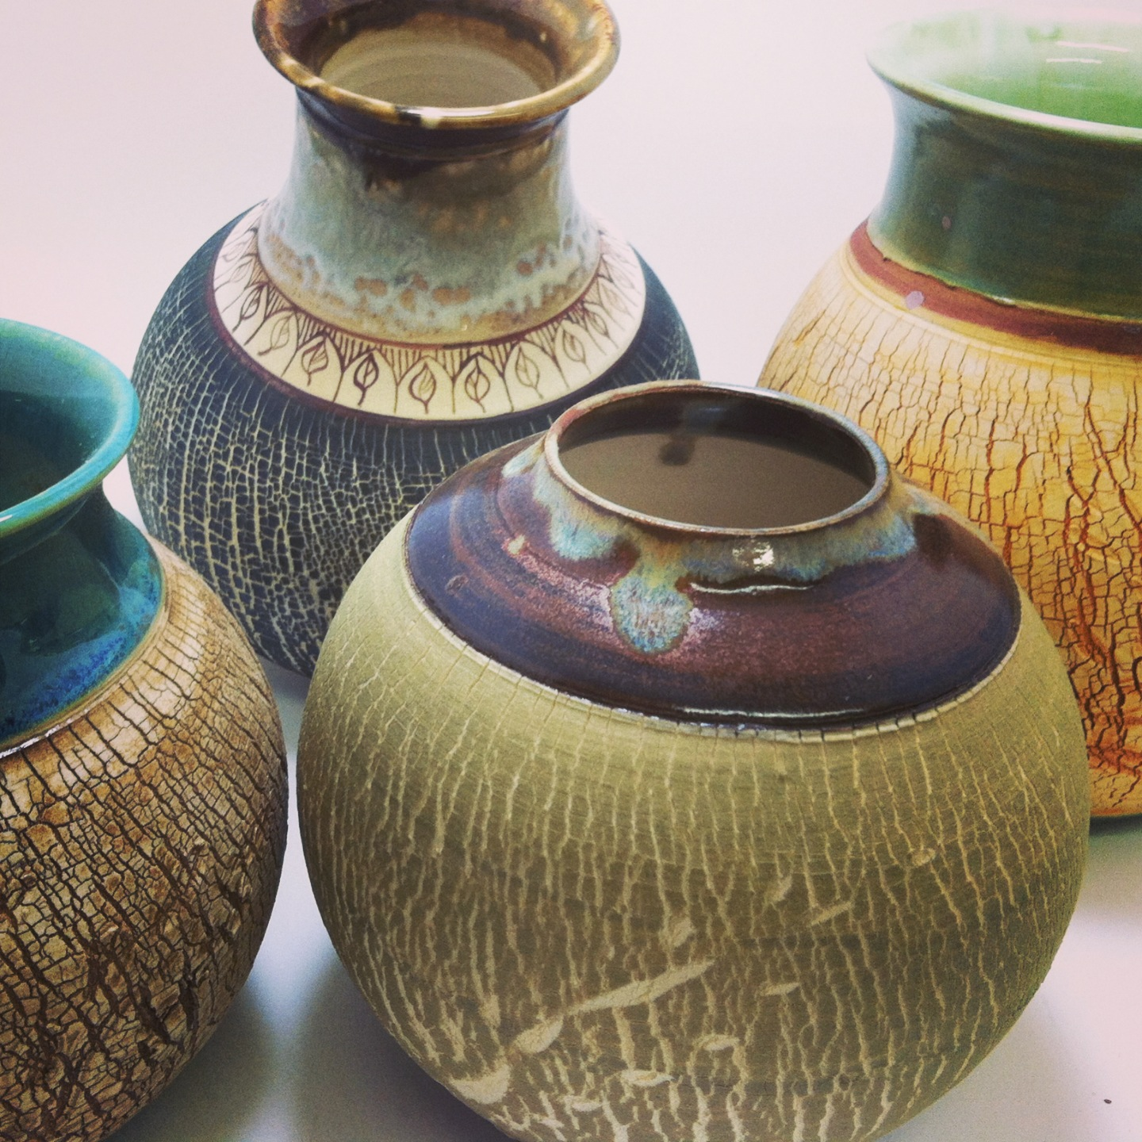
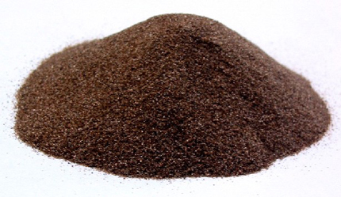
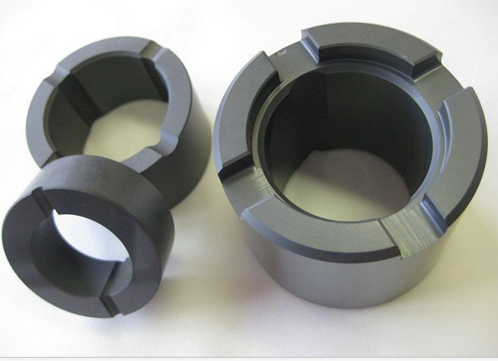
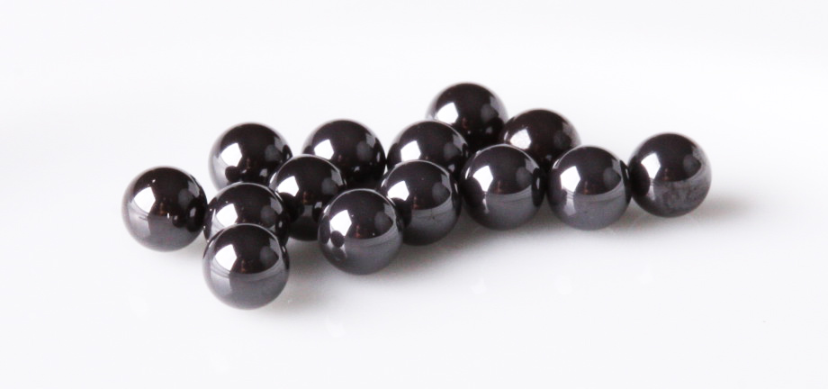
Composition base System
Oxide Ceramics
Silicate Ceramics
Carbide Ceramics
Nitride Ceramics

Slide 6
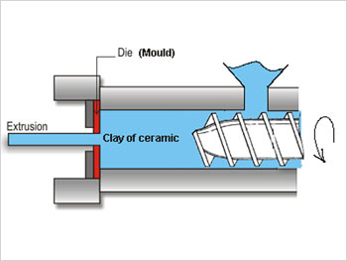
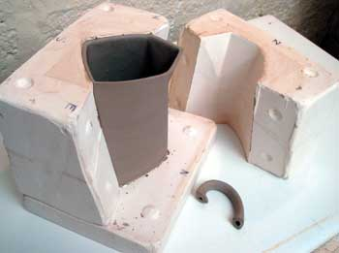
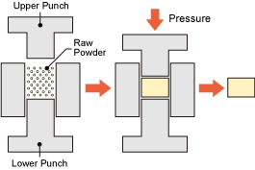
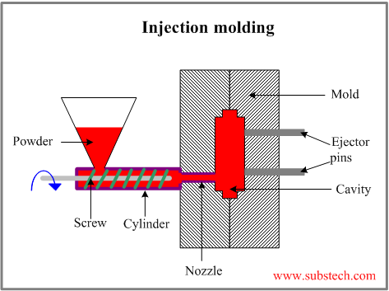
Ceramic Processing
Powder
Natural or Chemically Prepared
Water
And Additives Added
Shaping
Extrusion, Slip Casting, Pressing, Tape Casting, and Injection Molding.
Heat
Glazing (optional)

Slide 7
References
Johnson, R. (n.d.). What is a Ceramic ? Retrieved May 7, 2018, from https://depts.washington.edu/matseed/mse_resources/Webpage/Ceramics/ceramics.htm
Mason, T. O. (2011, January 24). Ceramic composition and properties. Retrieved May 7, 2018, from https://www.britannica.com/topic/ceramic-composition-and-properties-103137
Kopeliovich, D. (2012, June 01). Materials Engineering. Retrieved May 7, 2018, from http://www.substech.com/dokuwiki/doku.php?id=general_classification_of_ceramics
Johnson, R. (n.d.). Ceramic processing. Retrieved May 7, 2018, from https://depts.washington.edu/matseed/mse_resources/Webpage/Ceramics/ceramicprocessing.htm
Peterson, B. (2018, May 1). The Firing Process for Making Ceramics. Retrieved May 7, 2018, from https://www.thesprucecrafts.com/an-overview-of-the-firing-process-2746250

